Slide 1
Comprehension
Lesson 6
Mrs.West

Slide 2
Review our Procedures
Give it your BEST try.
Use tools appropriately .
Be Respectful.
A Pep Talk!

Slide 3
Notebook
Growth Mindset: What can you do to make the world more awesome?
Q1:
Q2: A Hyperloop is a maglev train traveling inside of a sealed tube so no air gets inside.
Q3: What is the author’s purpose? The author’s purpose was to inform us about Hyperloops.
What did you learn?
Air resistance is what stops a maglev train from going its top speed.

Slide 4
Agenda Today
A Pep Talk
Vocabulary
Close Reading
SBAC Questions

Slide 5
Let’s Review
Good Readers:
*Make a movie in your _______
*Always try to ___________ to the stories
*The 5 W’s Are: _____ _____ _____ ____ _____
*How many times should you read the story in a close read?

Slide 6
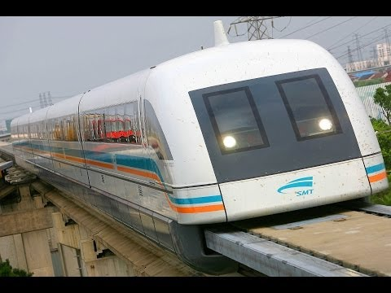
Vocabulary
Magnetic Levitation

Slide 7
Making Connections
Review! How can we do this and why do we do it?
Readers making connections about the text to themselves, the world around them, or other books they have read

Slide 8
Visualization
Readers use visualization to better understand a text. When
you use visualization, you use details to create pictures in
your mind. You imagine what is happening in the text.

Slide 9

Author’s Purpose
PIE
The MAIN reason for the story
Persuade - the authors writes to get you to do something or believe what they say
Inform - the author writes to give you information about a topic
Entertain - the author writes to tell you a story that you will enjoy

Slide 10
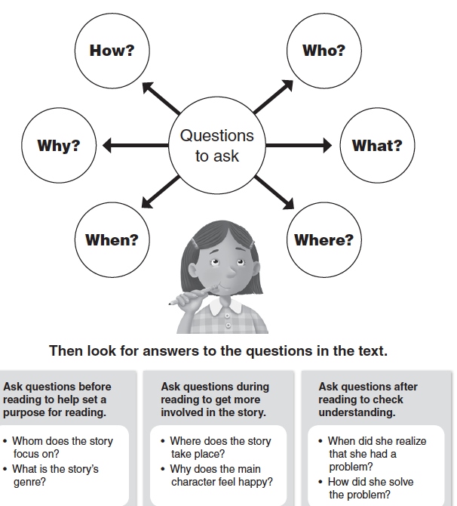
5 Ws
Strong Readers ask questions when they read a text. Asking questions before, during, and after helps in understanding a text.

Slide 11
Close Reading
Close reading is done by reading a text 2-3 times. This will build critical thinking, collaboration, and communication skills. Reading the text over and over helps the learner hear new information each time.
1st time- Figure out what the text is saying “visualize”
2nd time- Now that you know what it is saying- we will figure out the author's purpose and organization
3rd time- the meaning of the text - connect to the story in any way that we can

Slide 12
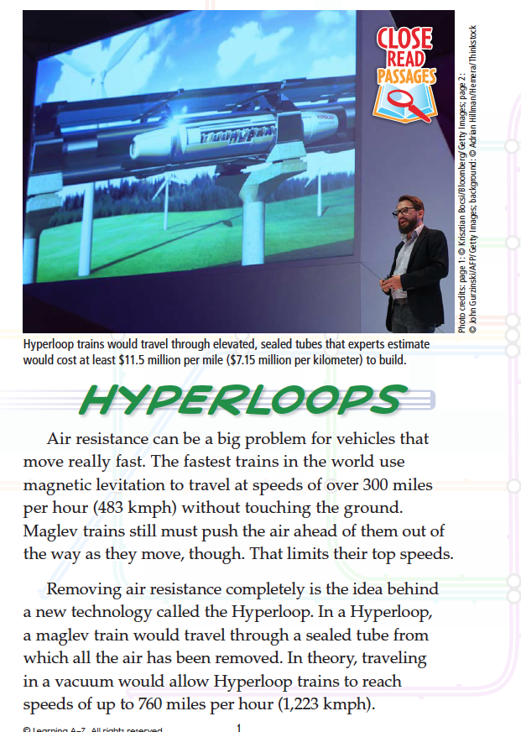
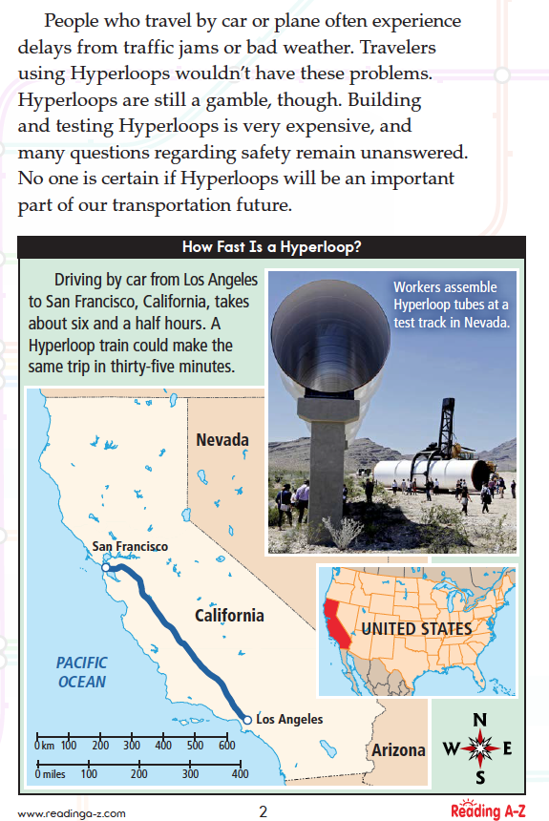

Slide 13
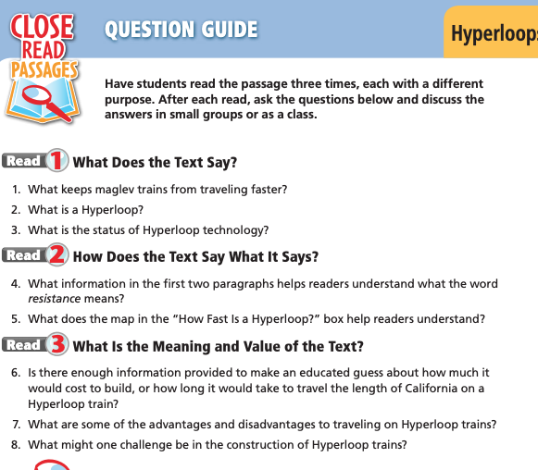

Slide 14
SBAC Questions
Go to the Website and choose a question to try out!

Slide 15
Review what we learned
Growth Mindset
Vocabulary
Close Reading
SBAC Questions

Slide 16
Lesson 6 Goal
Practice Making Connections to the stories you are reading!
Practice Visualizing the story! Make a movie in your head.
Practice working on understanding the organization of the story.
Review the 5 W’s
Website

Slide 17
Thanks!
Any questions?
You can always email me:
kelly.west@heartlandcharterschool.org

